Slide 1
(Zero-shot) Task Generalization
Xueliang Zhao (赵学亮)
Wangxuan Institute of Computer Technology, Peking University

Slide 2
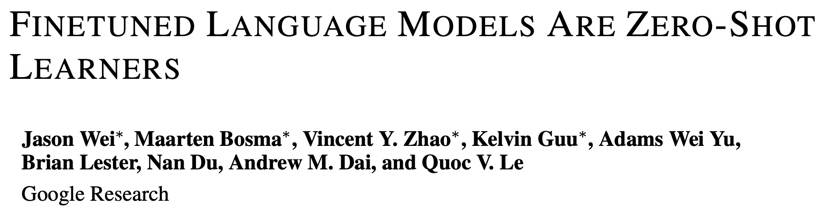

Slide 3
Introduction
Background & Challenges
Language models (LMs) at scale (e.g., GPT-3), have been shown to perform few-shot learning remarkably well, but less successful at zero-shot learning.

Slide 4
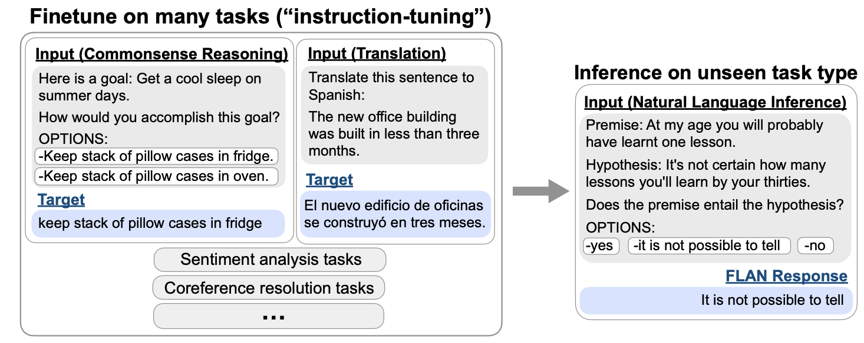
Introduction
Overview of instruction tuning and FLAN

Slide 5
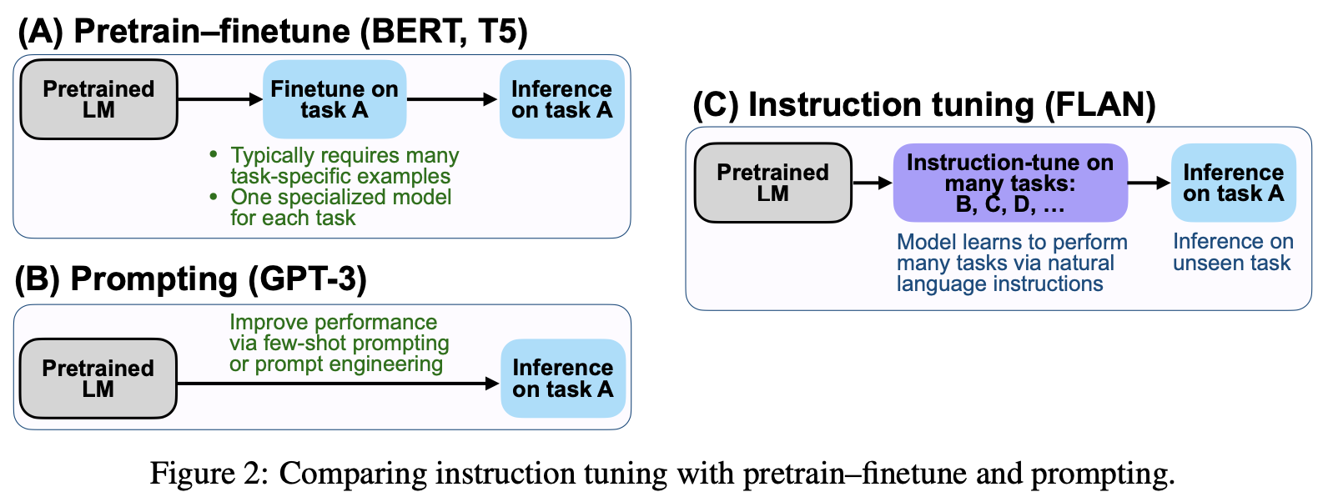
Introduction
Advantages of instruction tuning: combines appealing aspects of both the pretrain–finetune and prompting paradigms

Slide 6
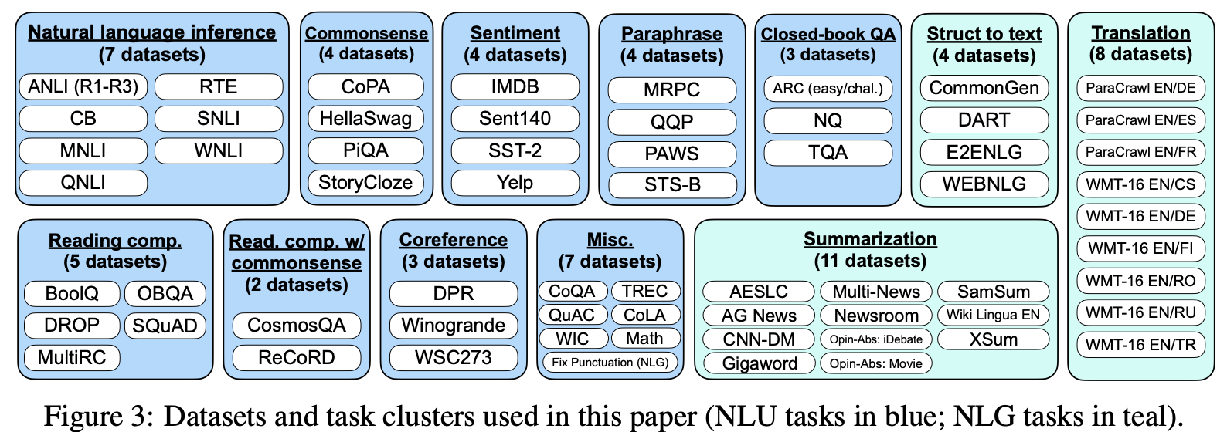
Methodology
Datasets and task clusters

Slide 7
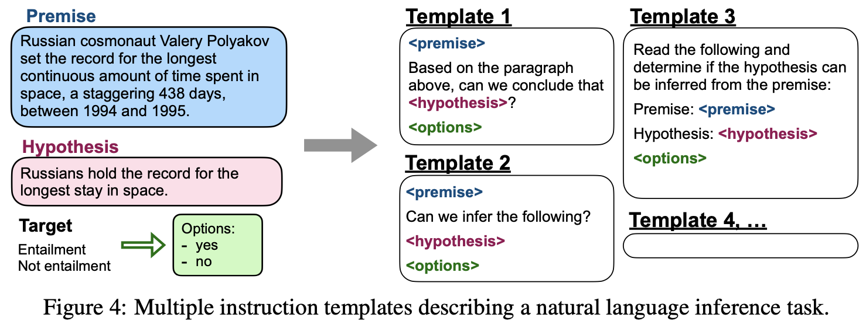
Methodology
Instructions / templates
For each dataset, 10 unique templates that describe the task, and up to 3 templates that “turn the task around”
Multiple instruction templates for NLI:

Slide 8
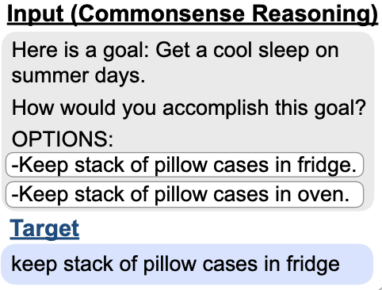
Methodology
For generation tasks
As FLAN is an instruction-tuned version of a decoder-only language model, so no further modifications are needed for generation tasks.
For classification tasks
Append the token OPTIONS to the end of a classification task along with a list of the output classes for that task
Make the model aware of which choices are desired when responding to classification tasks

Slide 9
Methodology
Training Details
Model architecture and pretraining (Base LM)
left-to-right, decoder-only transformer language model of 137B parameters
pretrained on a collection of web documents, dialog data, and Wikipedia (2.49T BPE tokens)
Instruction tuning procedure (FLAN)
To balance the different sizes of datasets, we limit the number of training examples per dataset to 30k and follow the examples-proportional mixing scheme (Raffel et al., 2020) with a mixing rate maximum of 3k.

Slide 10
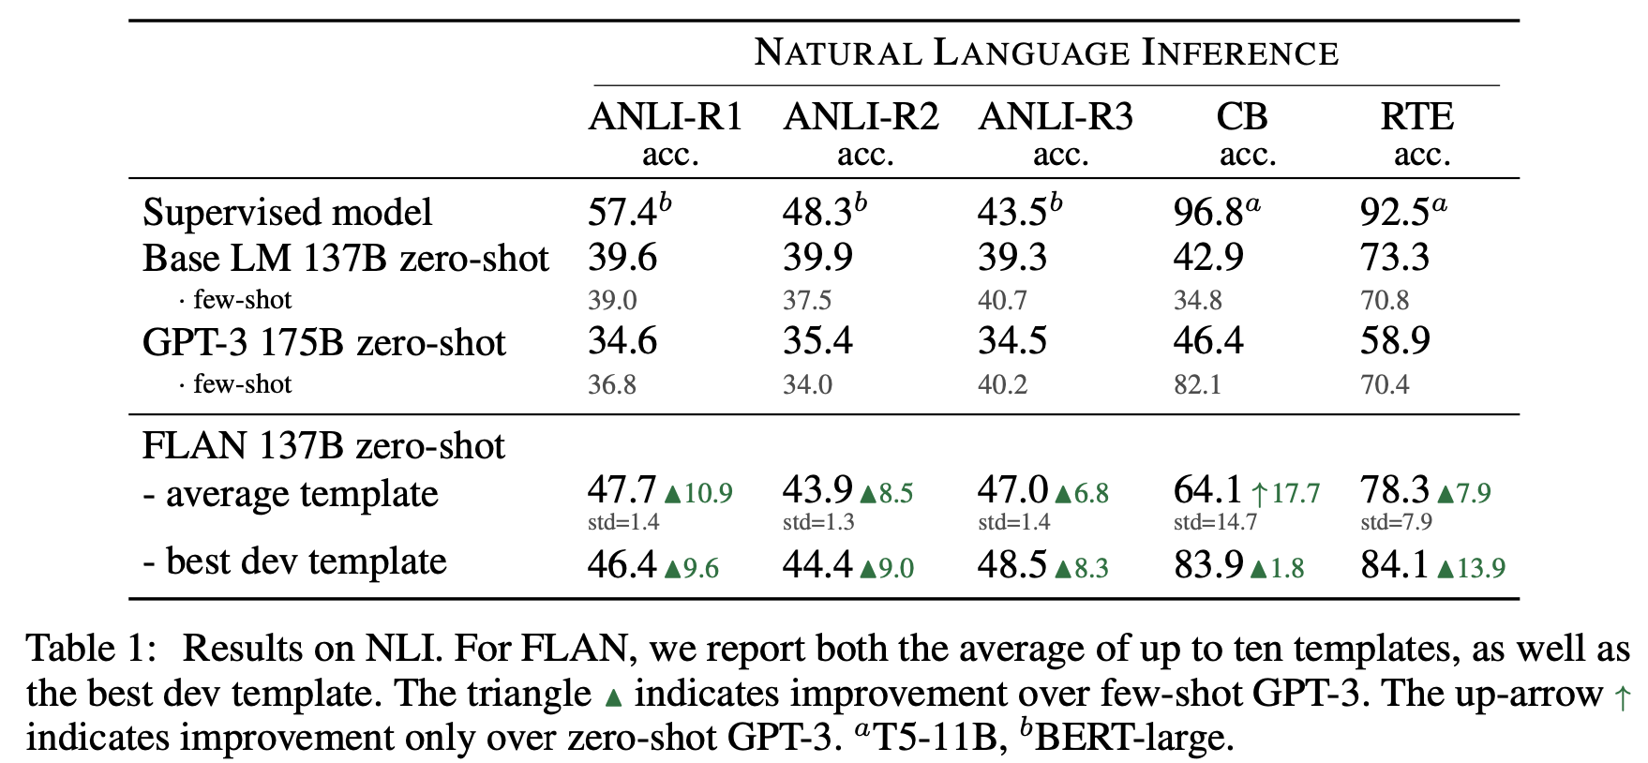
Experiment
Natural Language Inference
(For GPT-3) NLI examples are unlikely to have appeared naturally in an unsupervised training set, and are thus awkwardly phrased as a continuation of a sentence.
For FLAN, we phrase NLI as the more natural question “Does <premise> mean that <hypothesis>?”and achieve much higher performance.

Slide 11
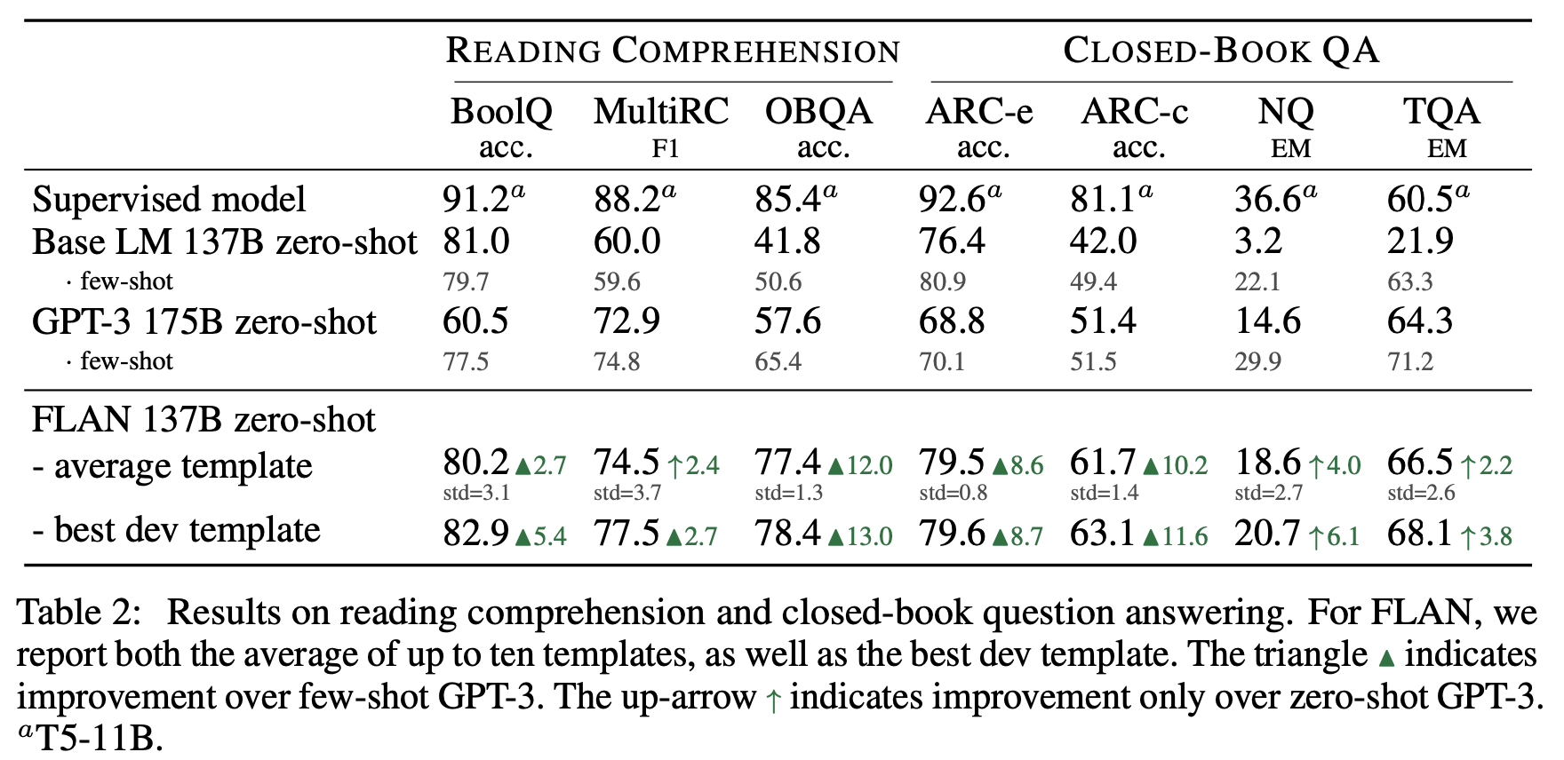
Experiment
READING COMPREHENSION & CLOSED-BOOK QA

Slide 12
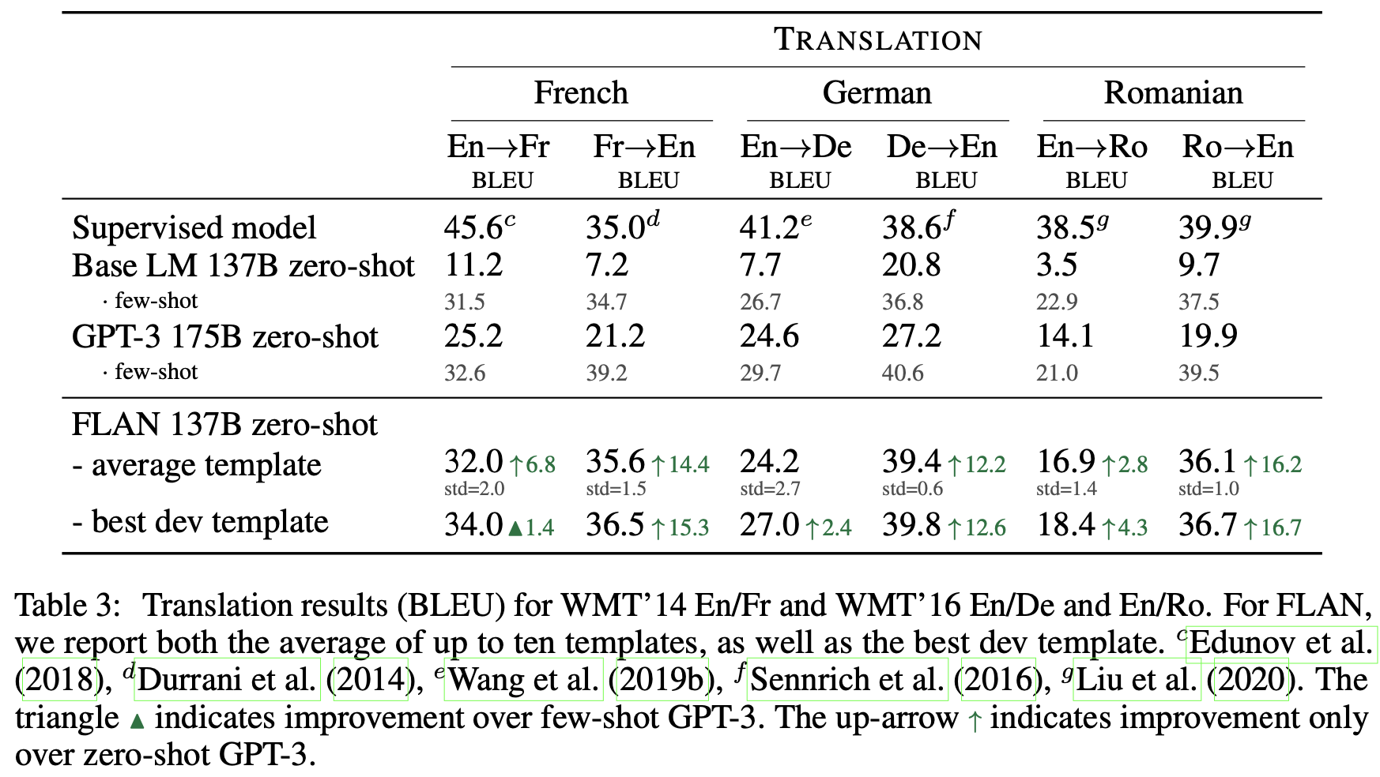
Experiment
TRANSLATION
Translating from English into other languages was relatively weaker, given that FLAN uses an English sentencepiece tokenizer and that the majority of pretraining data is English.

Slide 13
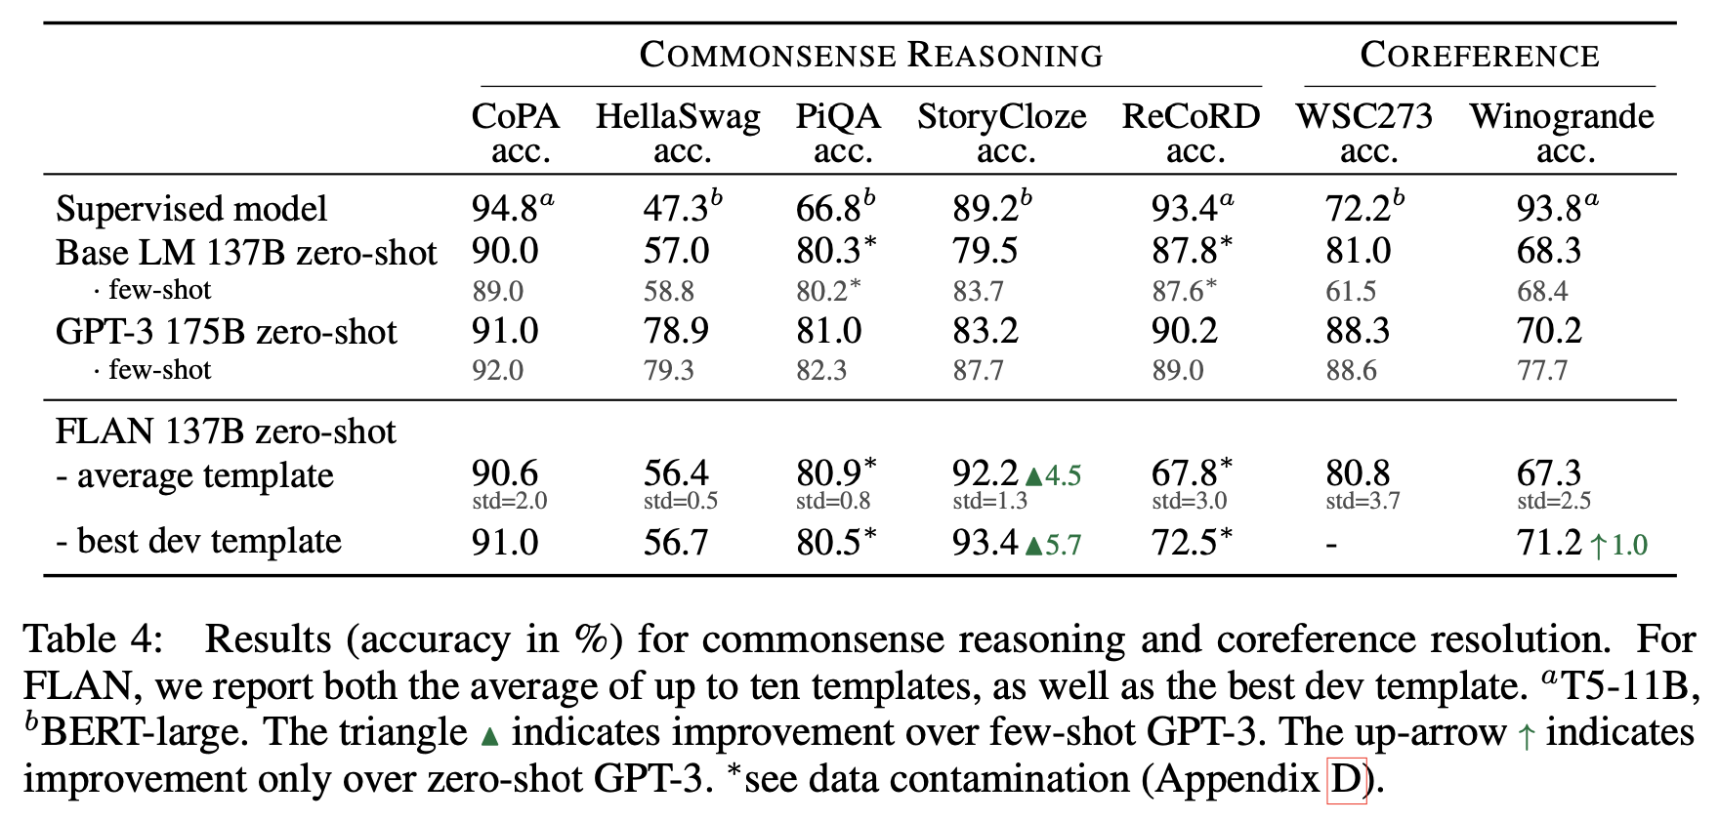
Experiment
Commonsense Reasoning and Coreference Resolution
When the downstream task is the same as the original language modeling pre-training objective, instruction tuning is not useful.

Slide 14
Experiment
Overall
Instruction tuning is very effective on tasks naturally verbalized as instructions (e.g., NLI, QA, translation, struct-to-text)
Instruction tuning is less effective on tasks directly formulated as language modeling (e.g., commonsense reasoning and coreference resolution tasks that are formatted as finishing an incomplete sentence or paragraph).

Slide 15
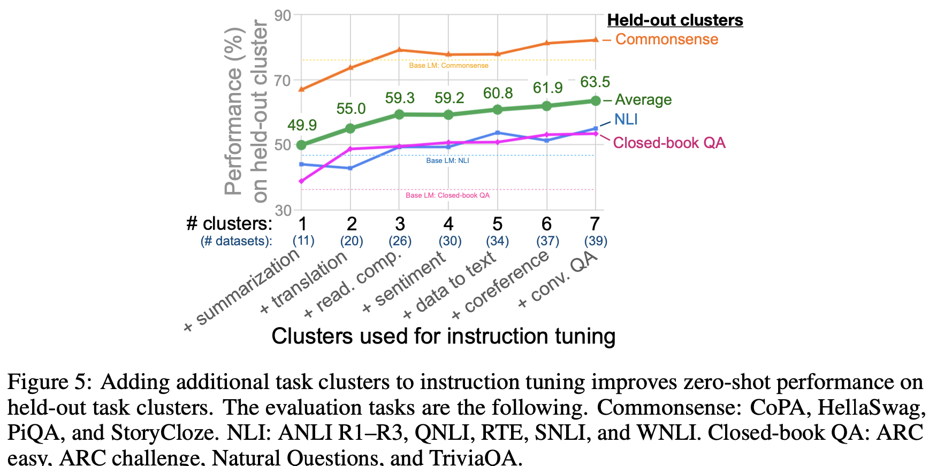
Experiment (Ablation)
NUMBER OF INSTRUCTION TUNING CLUSTERS
this ablation does not allow us to draw conclusions about which instruction tuning cluster contributes the most to each evaluation cluster

Slide 16
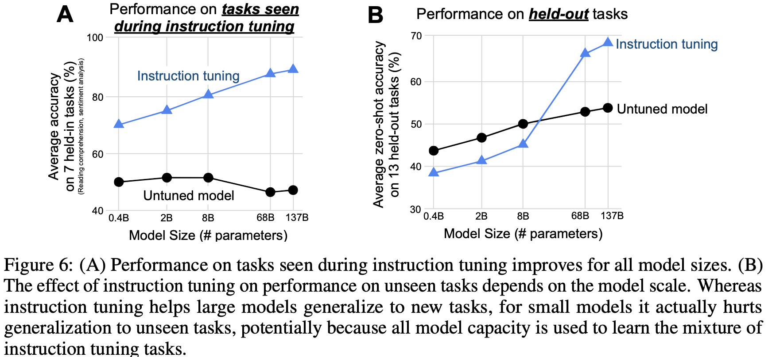
Experiment (Ablation)
SCALING LAWS
For small-scale models, learning the ∼40 tasks used during instruction tuning fills the entire model capacity, causing these models to perform worse on new tasks.
For the larger scale models, instruction tuning fills up some model capacity but also teaches these models the ability to follow instructions, allowing them to generalize to new tasks with the remaining capacity.

Slide 17
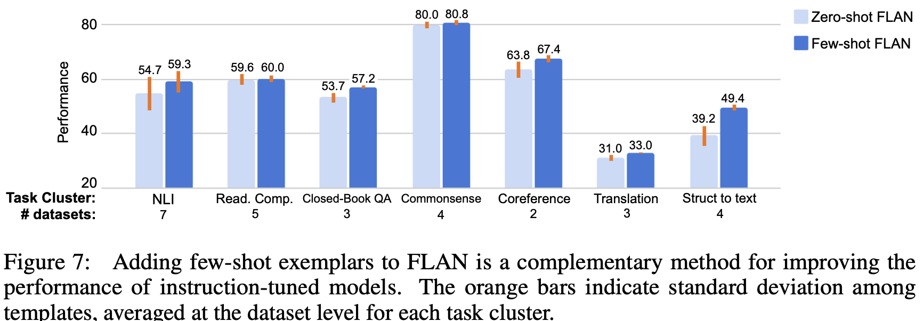
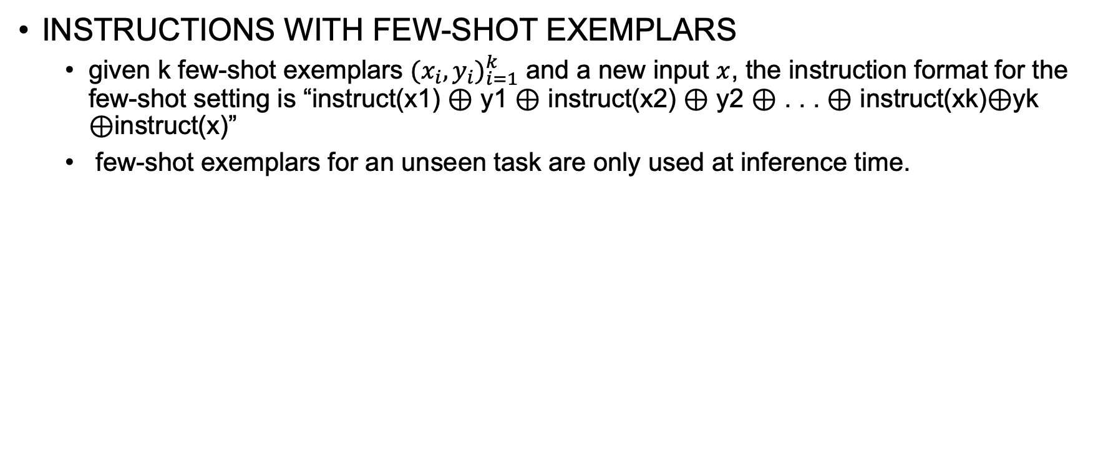
Experiment (Further Analysis)
INSTRUCTIONS WITH FEW-SHOT EXEMPLARS
given k few-shot exemplars ${(x_{i},y_{i})}_{i=1}^{k}$ and a new input $x$, the instruction format for the few-shot setting is “instruct(x1) ⊕ y1 ⊕ instruct(x2) ⊕ y2 ⊕ . . . ⊕ instruct(xk)⊕yk ⊕instruct(x)”
few-shot exemplars for an unseen task are only used at inference time.

Slide 18
Conclusion
Key components to the success of instruction tuning:
Number of clusters in instruction-tuning
Sufficient model scale

Slide 19
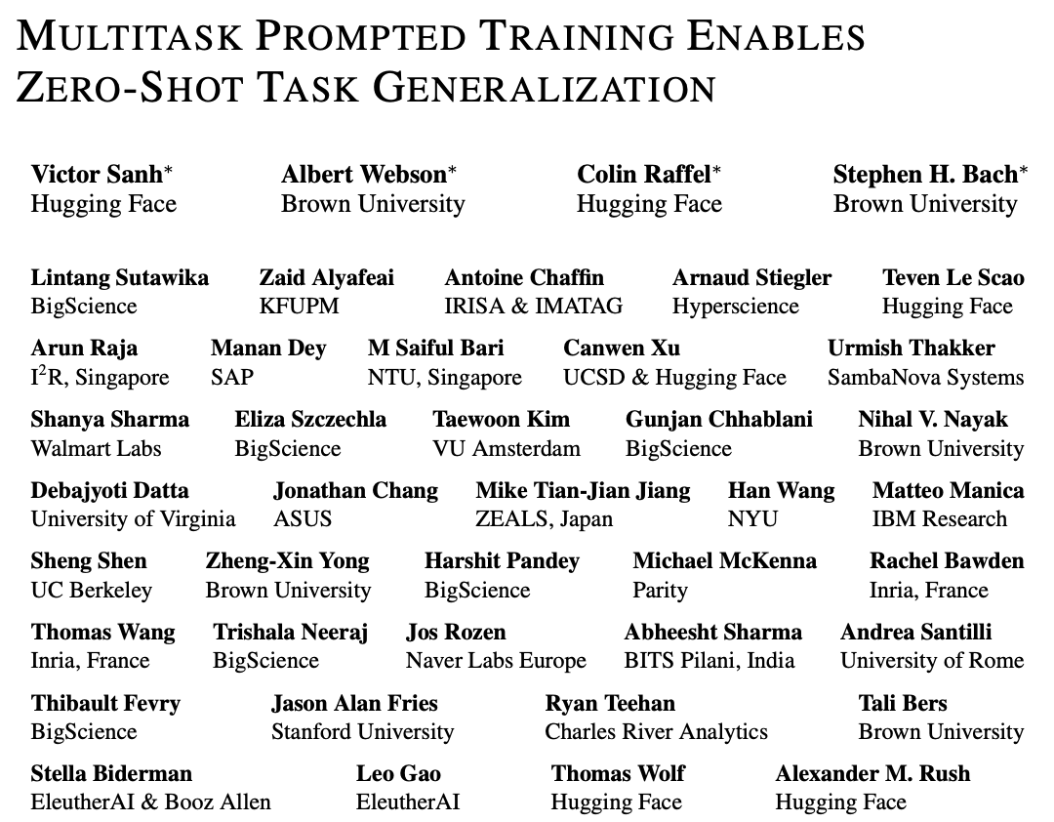

Slide 20
Introduction
Background
Large language models generalize to new tasks as a result of an implicit process of multitask learning
e.g., by training on generic text from a web forum, a model might implicitly learn the format and structure of question answering
Challenges
This ability requires a sufficiently large model and is sensitive to the wording of its prompts

Slide 21
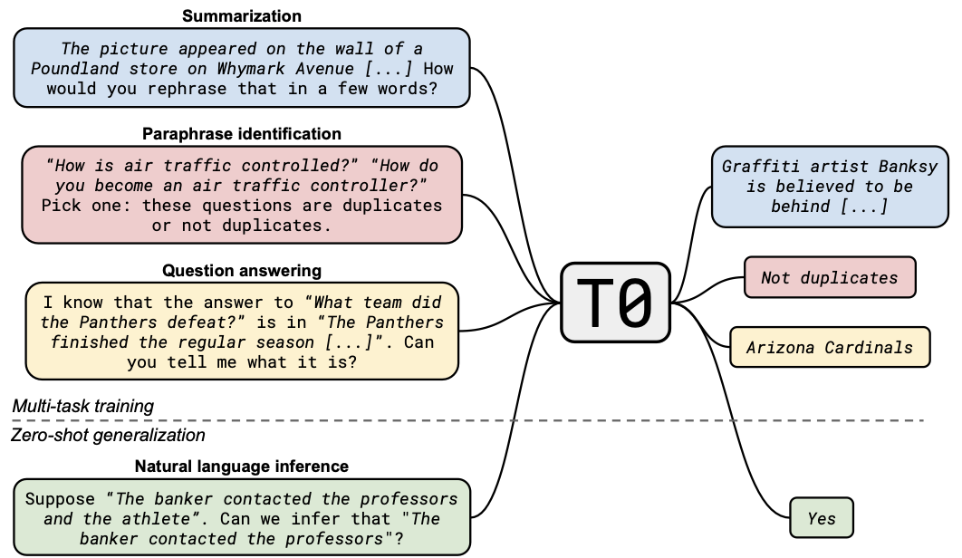
Introduction
Model (T0) and prompt format

Slide 22
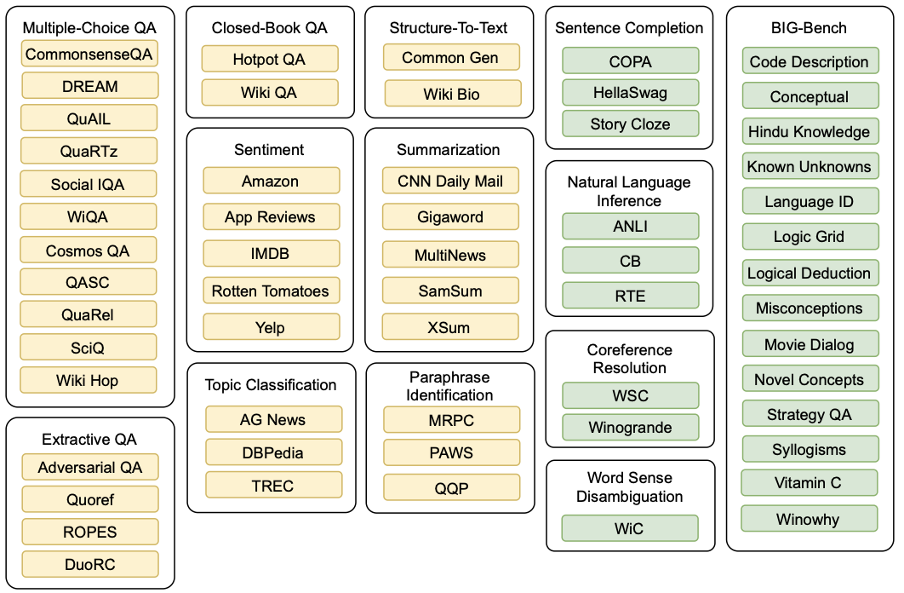
Introduction
T0 datasets and task taxonomy (Yellow: training; Green: evaluation)

Slide 23
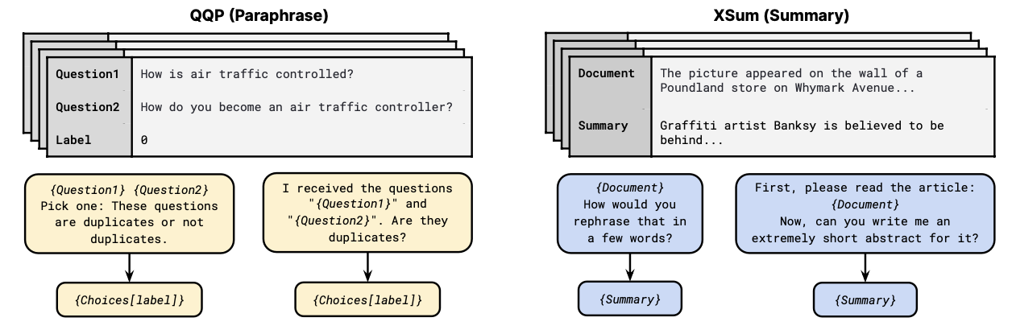
Methodology
A unified prompt format
Prompt templates from the Public Pool of Prompts (P3)

Slide 24
Methodology
Non-original-task prompts
Allowed prompts that permuted the original task (for instance, generating a document from its summary)
Or allowed for ambiguous output (for instance, not indicating a list of available choices)

Slide 25
Experiment (Setup)
Model
fine-tune a pretrained model (T5+LM) on our multi-task training mixture of natural language prompted datasets
use an encoder-decoder architecture, which is trained to autoregressively generate the target through standard MLE
use the XXL version which has 11B parameters.

Slide 26
Experiment (Setup)
Training
Variants
T0: trained on the multitask mixture (yellow datasets)
T0+: the same model but trained on a mixture that adds GPT-3’s evaluation datasets
T0++: add GPT-3’s and SuperGLUE (Wang et al., 2019a)’s datasets to the training mixture which includes some held-out tasks.
Sampling
sampling from each dataset in proportion to the number of examples in the dataset
follow the strategy used in Raffel et al. (2020) and treat any dataset with over 500’000 examples as having 500’000 / num templates examples
choosing the checkpoint that yields the highest score on the validation splits of our training datasets

Slide 27
Experiment (Setup)
Evaluation
Evaluate zero-shot generalization on 11 NLP datasets in 4 unseen tasks: natural language inference, coreference, word sense disambiguation, and sentence completion (green datasets)
Also evaluate on 14 datasets from BIG-Bench (BIG-bench collaboration, 2021).

Slide 28
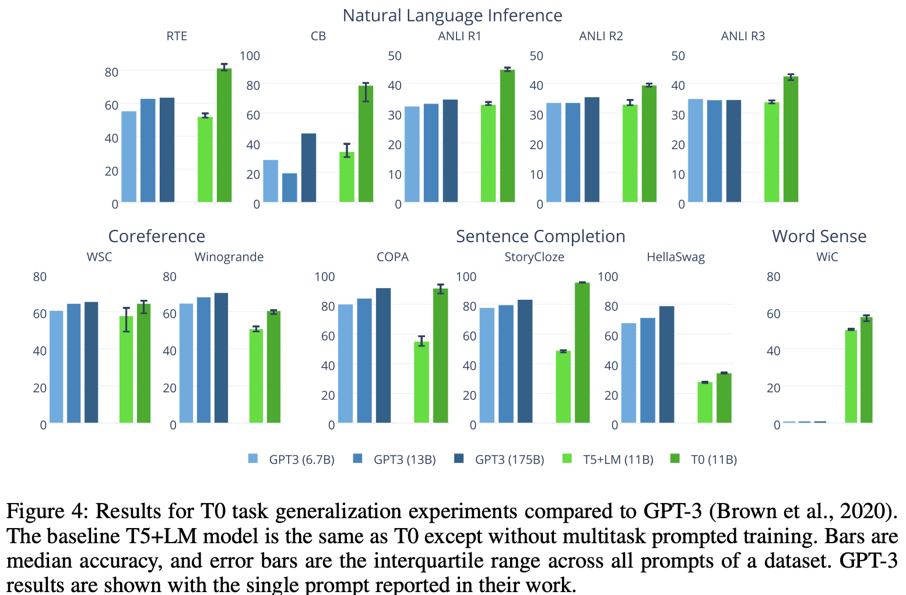
Experiment (Generalization to Unseen Tasks)

Slide 29
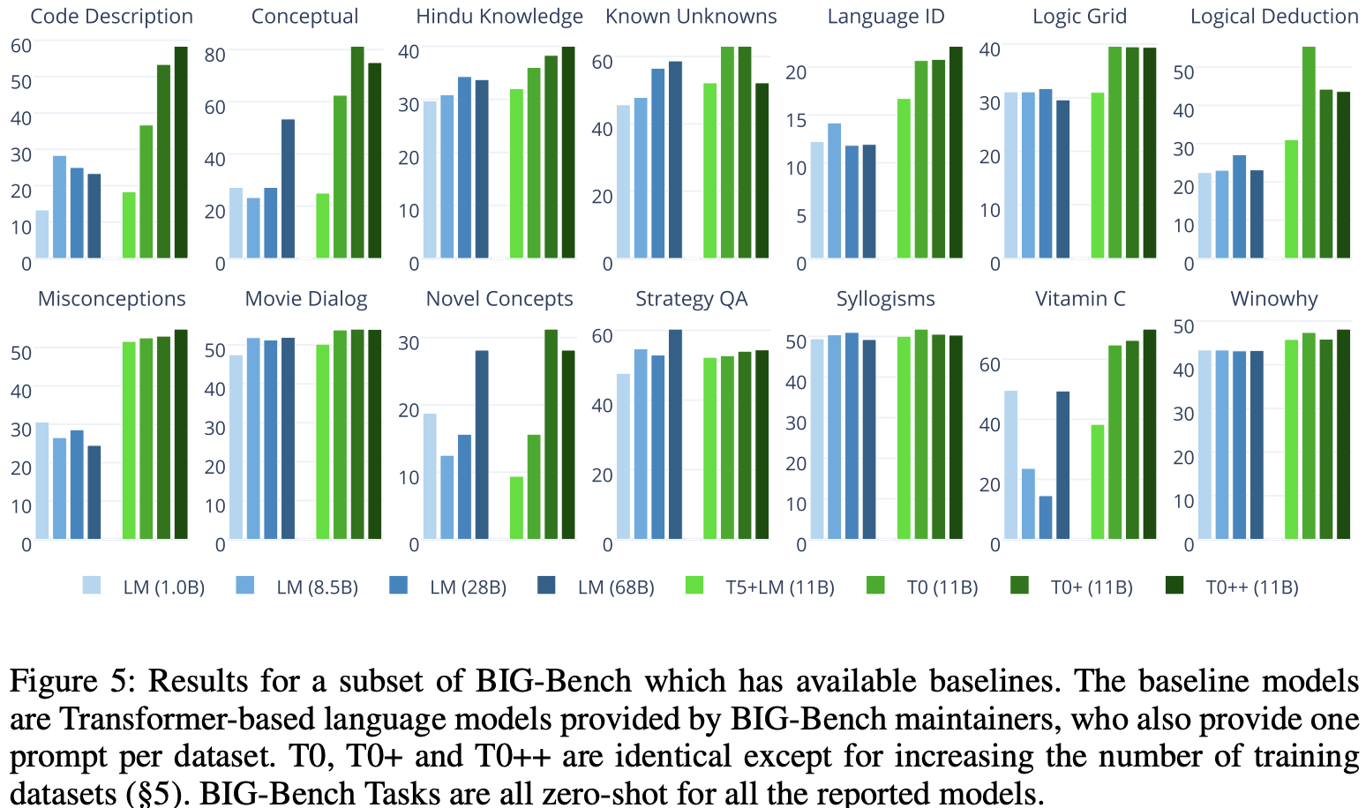
Experiment (Generalization to Unseen Tasks)

Slide 30
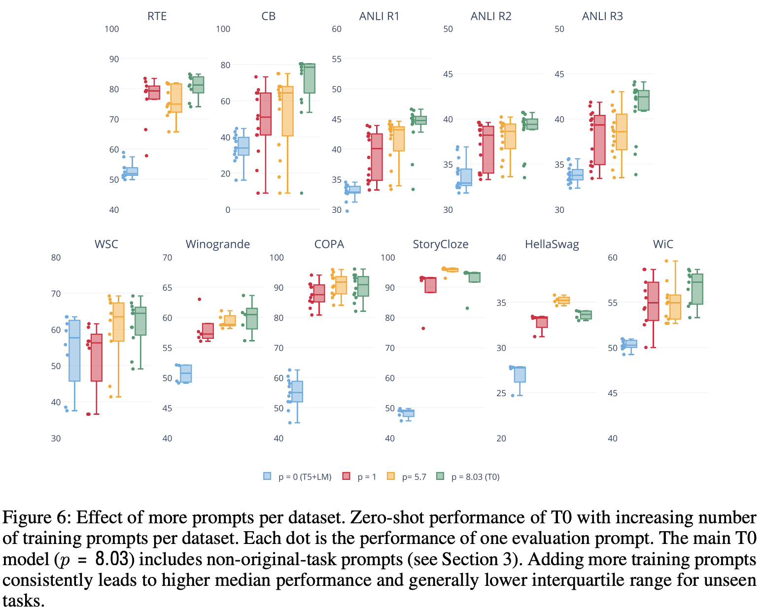
Experiment (Prompt Robustness)

Slide 31
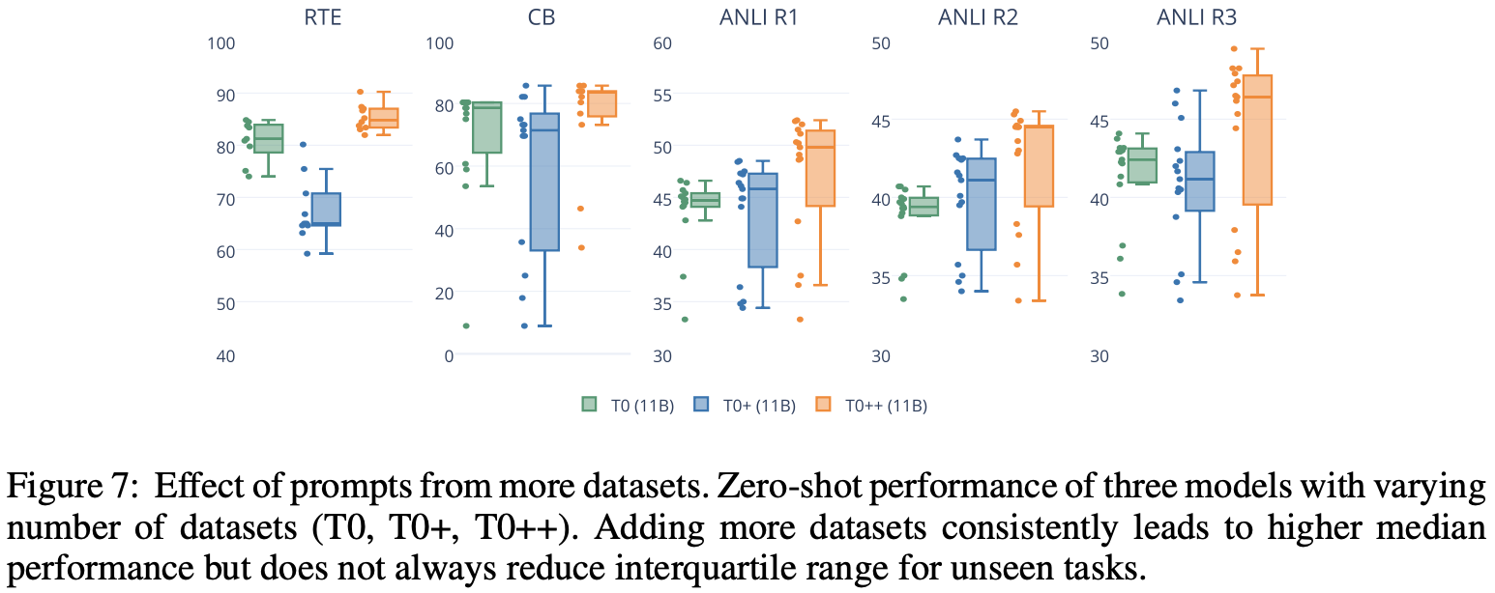
Experiment (Prompt Robustness)

Slide 32
Conclusion
Key components to zero-shot generalization abilities
including many diverse prompts
increasing the number of datasets in each task

Slide 33
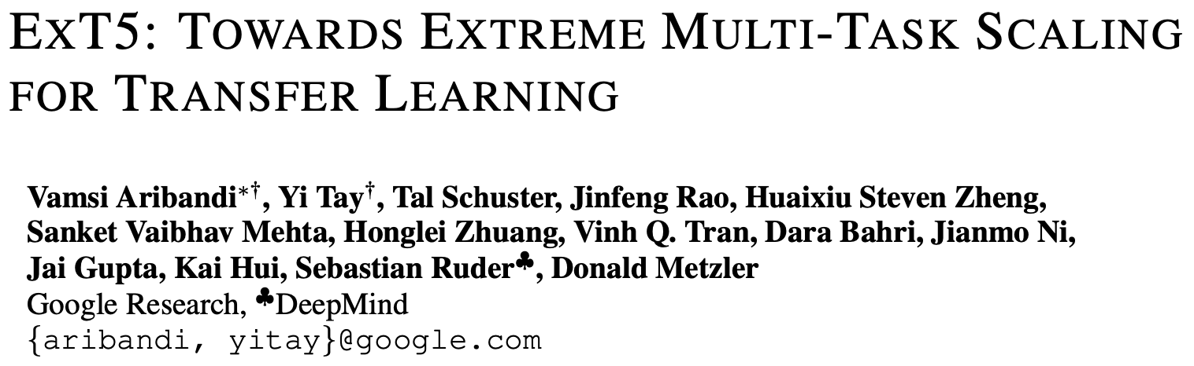

Slide 34
Introduction
Background & Challenges
(Negative Transfer) Prior seminal works like T5 and MT-DNN have demonstrated a degree of promise in the paradigm of multi-task co-training. However, the challenge of catastrophic forgetting remains.
(Sample Efficience) Certain types of skills such as commonsense knowledge are only acquired at a slow rate even using massive amounts of unlabeled data.

Slide 35
Methodology
EXMIX (Extreme Mixture)
a collection of 107 diverse English NLP tasks totaling 18M examples.
examples from each dataset are sampled proportionate to the individual dataset’s size, with each dataset’s sampling rate capped at 3 × 105 maximum effective examples.

Slide 36
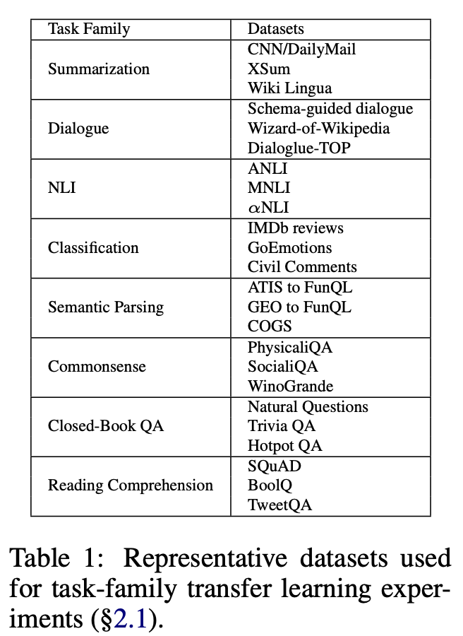
Methodology
TRANSFER RELATIONS BETWEEN EXMIX TASKS
To study transfer amongst task-families in EXMIX, we construct subsets (Table 1) of 3 tasks each that are partitioned along their task family.
We did not include other types of tasks because they were not diverse enough to be representative of a task family.
Each model is fine-tuned on T5.1.1_{BASE} for 200k steps.

Slide 37
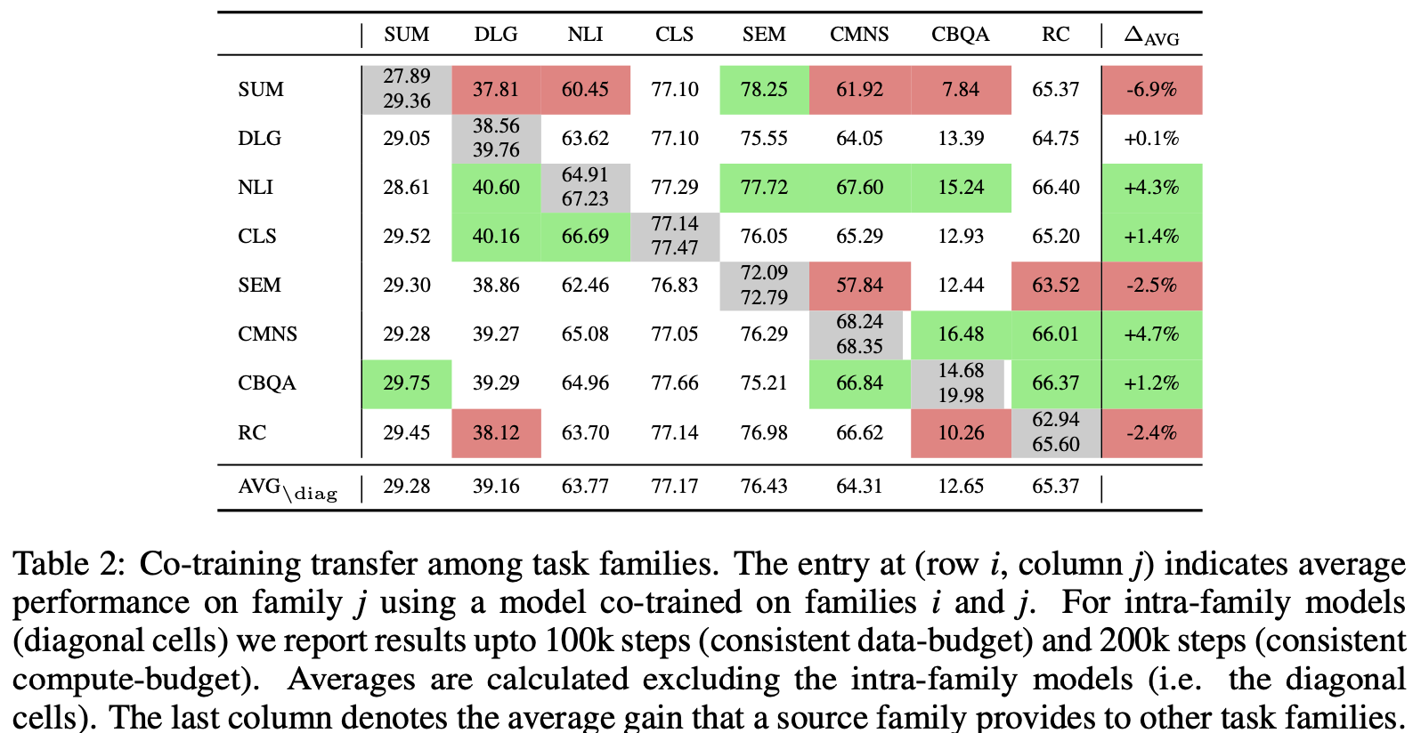
Methodology
TRANSFER RELATIONS BETWEEN EXMIX TASKS

Slide 38
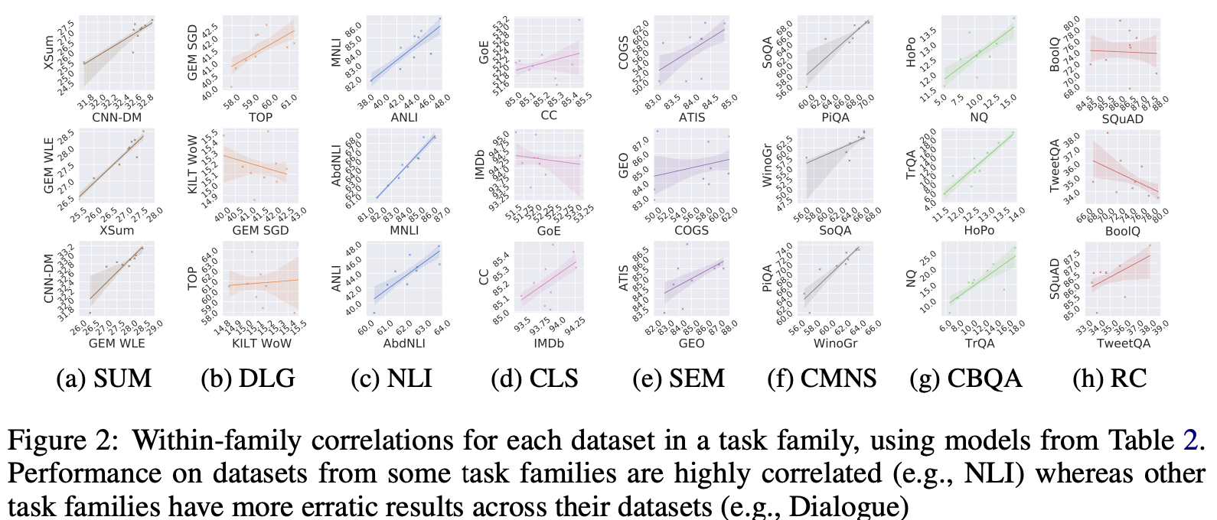
Methodology
TRANSFER RELATIONS BETWEEN EXMIX TASKS

Slide 39
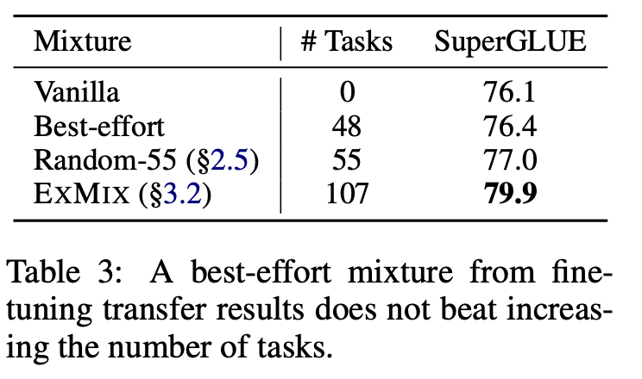
Methodology
CAN FINE-TUNING TASK RELATIONSHIPS HELP CURATE A PRE-TRAINING MIXTURE?
we include NLI, commonsense, classification, and closed-book QA tasks from EXMIX to form a mixture of 48 tasks to include in a multi-task pre-training setup.
We then fine-tune the resulting model on SuperGLUE, comparing it to T5.1.1 and EXT5.
Conclusion
negative transfer during multi-task fine-tuning does not necessarily inhibit pre-training.
randomly including more diverse pre-training tasks generally improves downstream performance.

Slide 40
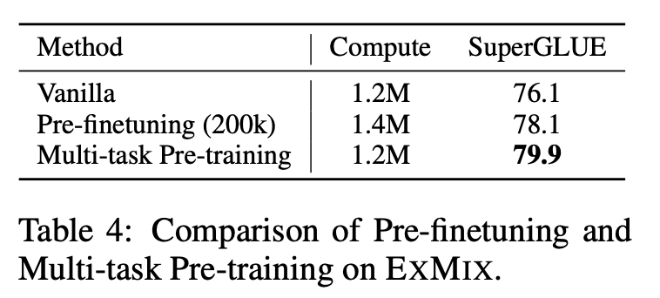
Methodology
MULTI-TASK PRE-TRAINING VS PRE-FINETUNING
Multi-task pre-training narrows the gap between pre-training and finetuning data distributions, as the pre-training stage more closely resembles fine-tuning.
Conversely, segregating pre-training and pre-finetuning into two different stages may induce catastrophic forgetting of the pre-training task.

Slide 41
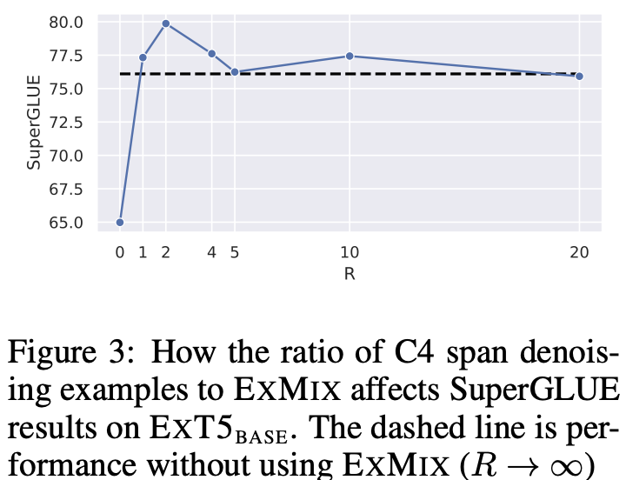
Methodology
HOW MUCH LABELED DATA SHOULD BE MIXED?
While EXMIX improves the pre-training process, self-supervised training over a large unstructured corpus is still crucial.

Slide 42
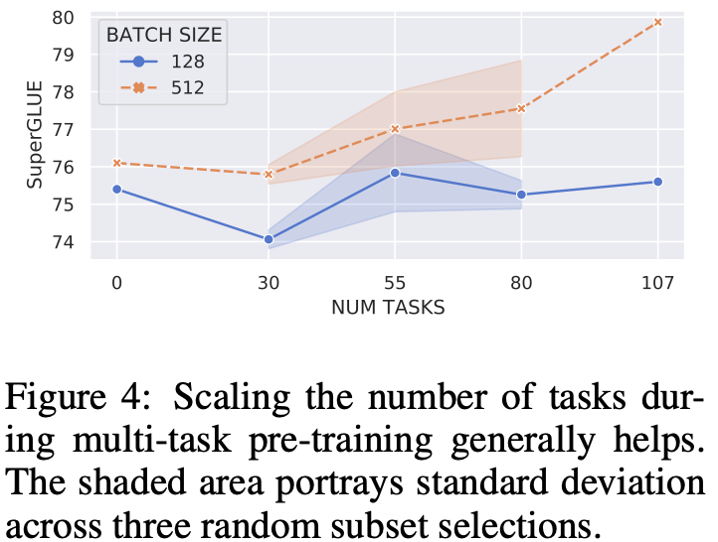
Methodology
DOES ADDING MORE TASKS HELP? TASK SCALING EXPERIMENTS
With small batches, there is less of an upward trend, signifying that large batches are essential for a large number of tasks, given that multi-task learning may cause gradients to be noisy.
Large-batch training can offer benefits even for single-task models.

Slide 43
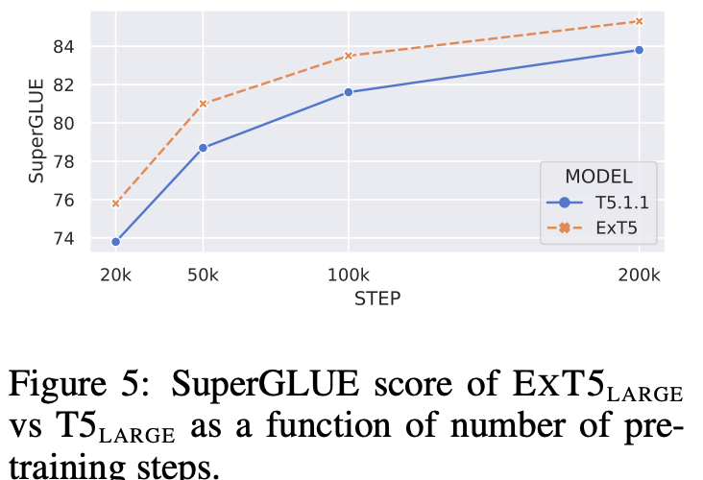
Methodology
IMPROVING SAMPLE EFFICIENCY WITH EXMIX
At only 20k pre-training steps, our ExT5 model already achieves 75.8 SuperGLUE score, which outperforms a fully pre-trained BERT large model by about +4%

Slide 44
Experiment
Pre-training
We pre-train EXT5 on the same number of steps as T5, and EXT5 sees an identical number of tokens to the released T5 models.
Fine-tuning
Follow the same fine-tuning procedure for T5 and EXT5 for fair comparison

Slide 45
Experiment (Setup)
Within-mixture
Measure the amount the task benefits from multi-task pre-training and extreme task scaling.
Continue to fine-tune on the target task from a pre-trained ExT5 checkpoint.
Out-of-mixture
Consider possibly new unseen tasks or collections that were not included in the EXMIX mixture to test the effect of generalizing to unseen tasks.
Fine-tune and evaluate on Machine Translation, Reasoning and Named Entity Recognition.

Slide 46
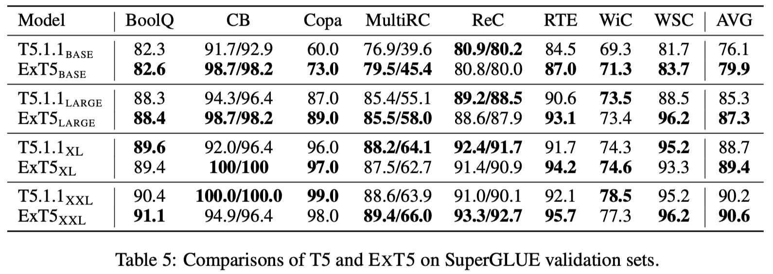
Experiment (Within-Mixture Results)

Slide 47
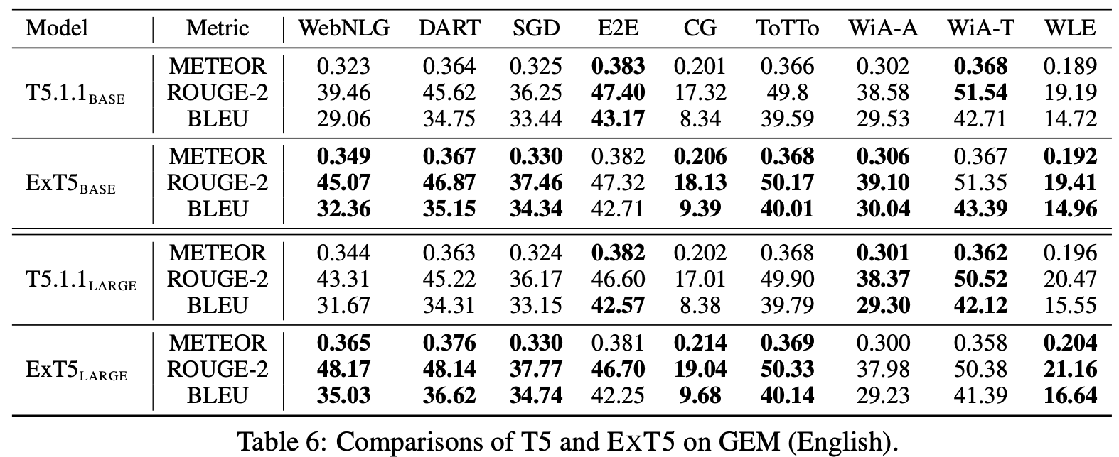
Experiment (Within-Mixture Results)

Slide 48
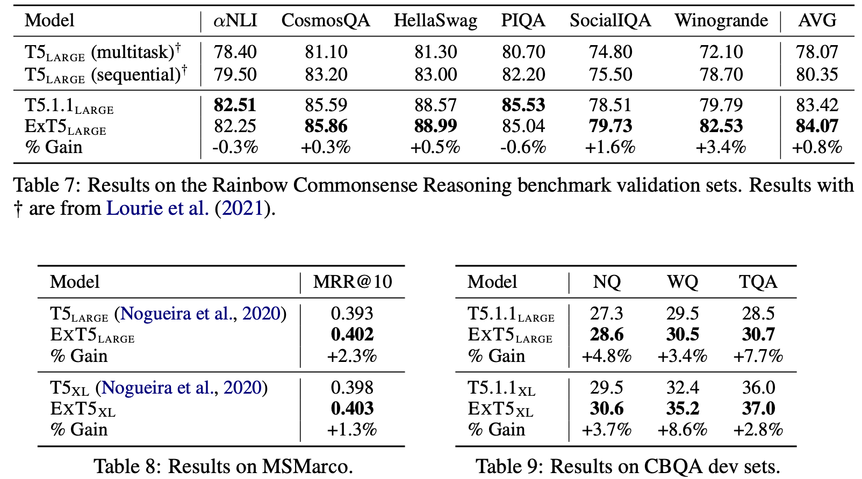
Experiment (Within-Mixture Results)

Slide 49
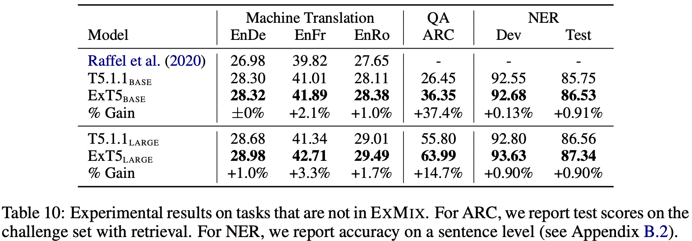
Experiment (Out-of-Mixture Results)
The largest improvement is on the ARC scientific reasoning task, perhaps due to the large amount of QA tasks in EXMIX.
The representations learned by EXT5 are more general adaptable to a new objective, even when the output is in a new language.

Slide 50
Conclusion
While negative transfer is common when fine-tuning on diverse tasks, scaling up the number of tasks to include in a multi-task pre-training setup enables strong downstream performance with better sample-efficiency

